Slide 1
Using Scrum to Manage the
Testing Effort
Software Test & Performance Conference: April 17-19, 2007
Bob Galen
RGalen Consulting Group, LLC
www.rgalen.com bob@rgalen.com
Notes:
F6 - Manage Your Testing with SCRUM
Robert Galen, Thomson/Dialog
Test Management
Friday, 11:15 a.m.
#038
Used successfully in hundreds of agile and iterative development projects, SCRUM is a software
project management approach that employs fixed cycle time “sprints” and daily “scrums.” SCRUM
emphasizes self-directing teams and the role of a “Scrum Master” to remove obstacles to the
team’s success. Because testing often succumbs to delivery pressures and becomes chaotic,
especially during the endgame of projects, SCRUM can be an extremely helpful management
framework for test groups. By implementing SCRUM practices, you increase the focus of test
efforts on the most important actions, empower the test team, improve morale, and heighten
your influence on the overall success of the project. Learn how Robert Galen instituted SCRUM in
a test department, overlaying this new framework on existing processes with a surprisingly
positive impact on both the people and the product.
· An overview of the SCRUM methodology and its application to test teams
· Manage testing as a product backlog activity prioritized with and by your customers
· Implementing daily scrums, sprints, and sprint reviews

Slide 2
Outline
Primer on the SCRUM agile methodology
  Pulling out core SCRUM practices that may be applied to testing efforts
Within a testing context:
  Backlogs
  Sprints and goals
  Daily SCRUM – dynamics
  Tracking progress
  Retrospective
  Conclusions / Q&A
Notes:
For STAR, the presentation timeframe is 45 minutes – with some time for Q&A. That isn’t a whole lot of time. I think that leaves me 15 minutes for Scrum, 15 minutes for Testing Implications and 15 minutes for Wrap Up.
Review of initial presentation at STAR East 2005. The primer took about 20-25 minutes to present. I built in some context in this section about my thinking. The Scrum in testing section then lasted about 20-25 more minutes. I ended up with about 15 minutes for Q&A. I took no questions during the session, so changing that might change the tempo and time a bit.
A useful entry strategy was to speak about my development background and experience using Scrum in my “Endgames”. Then translate that experience to be “transfer” to more QA leadership work.

Slide 3
Introduction & Goals
This presentation is less about Scrum the methodology and more about applying Scrum practices within your testing teams and efforts. In essence, wrapping Scrum around your existing efforts.
Key goals for the talk include:
Expose you to the Scrum methodology
Spur your thinking about possible application of Scrum attributes to your testing projects
Sensitize you to the power of self-directed teams
No silver bullets, but motivate you to try it
Notes:
Background for the talk. It’s been my experience that testing more reacts to the ebb and flow of the development team, rather than having a methodology for managing the testing work activity. Sure, most of my testing efforts have completed plans of some sort and usually rather detailed schedules. However, once the releases started flying, usually this falls out the window – and we were left in a reactive mode to what was being delivered.
Scrum practices don’t necessarily change this pattern. However, they do provide a mechanism for intelligently (choosing) what will be worked on and how and (focusing) on this for at least an iteration.
Not only does it leverage your teams’ ability to compensate and effectively react to change, but it ‘exposes’ these decisions to the team and beyond.
These are a few of the reasons why I like Scrum so much in managing around Endgame dynamics.

Slide 4
Agile Manifesto & Methodologies
  Extreme Programming
  Scrum
  Adaptive Software Development (ASD)
  Crystal Clear
  Dynamic Systems Development Method (DSDM)
  Feature Driven Development (FDD)
  Lean software development
  Microsoft Solution Framework (MSF)
  Agile Unified Process (AUP)
http://agilemanifesto.org/
We are uncovering better ways of developing software by doing it and helping others do it. Through this work we have come to value:
Individuals and interactions over processes and tools
Working software over comprehensive documentation
Customer collaboration over contract negotiation
Responding to change over following a plan
That is, while there is value in the items on the right, we value the items on the left more.
Notes:
http://en.wikipedia.org/wiki/Agile_software_development

Slide 5
Principles behind the Agile Manifesto
Our highest priority is to satisfy the customer through early and continuous delivery of valuable software.
Welcome changing requirements, even late in development. Agile processes harness change for the customer's competitive advantage.
Deliver working software frequently, from a couple of weeks to a couple of months, with a preference to the shorter timescale.
Business people and developers must work together daily throughout the project.
Build projects around motivated individuals. Give them the environment and support they need, and trust them to get the job done.
The most efficient and effective method of conveying information to and within a development team is face-to-face conversation.

Slide 6
Principles behind the Agile Manifesto
Working software is the primary measure of progress.
Agile processes promote sustainable development. The sponsors, developers, and users should be able to maintain a constant pace indefinitely.
Continuous attention to technical excellence and good design enhances agility.
Simplicity--the art of maximizing the amount of work not done--is essential.
The best architectures, requirements, and designs emerge from self-organizing teams.
At regular intervals, the team reflects on how to become more effective, then tunes and adjusts its behavior accordingly.

Slide 7
Scrum Primer

Slide 8


Introduction
Jeff Sutherland – first implemented Scrum at Easel Corp. in 1993
Ken Schwaber provided initial formal definitions in 1995 paper and at OOPSLA 96
ASD w/Scrum book published in 2001 by Schwaber and Mike Beedle
APM w/Scrum published in 2004
Applied to hundreds of projects
View it as an “Agile Project Management wrapper” for software projects
Notes:
I was exposed to Scrum in the mid 1990’s. I immediately began using some of the principles within phases of my projects. In my particular case, I mostly wrapped Scrum around the delivery endgame – because I was developing quite a few projects.
Even to this day, I try not to refer to it as Scrum – because of the negative reactions. I simply apply the techniques and lightly reference the methodology. It is, at least from my POV, one of the least known and understood of the agile methods. It doesn’t help that it doesn’t directly incorporate software development practices.
The most recent book reviews example projects and introduces case studies to illustrate Scrum practices. It was sorely needed because the previous book was a bit theoretical and hard to comprehend.

Slide 9
Characteristics
One of the Agile Methodologies, a Project Management “Wrapper”
Fosters self-organizing teams
Product progresses or iterates in a series of month-long “sprints”
Requirements are captured as items in a “product backlog” list
No specific engineering practices prescribed
Uses generative rules to create an agile environment for delivering projects
Notes:
All of the Agile Processes are, at least to my thinking, humanistic. They hold that process itself doesn’t matter that much as a means of achieving success. More so, the people within your teams are the core success factors. This is the core of the self-organizing notion for teams.
The only one of the Agile Methods that is “independent” of software development practices or methods. From that POV, it can wrap virtually any activity in an Agile envelope for execution.
I most often see XP development practices or XP proper wrapped in Scrum. It’s sometimes hard to speak in terms of Scum (without) actually referencing your development practices and methodology.

Slide 10
Process Overview
Source: Adapted from Agile Software Development with Scrum by Ken Schwaber and Mike Beedle.
24 hours
Daily Scrum
Meeting
Backlog tasks
expanded
by team
30 days
Sprint Backlog
Potentially Shippable
Product Increment
Product Backlog
As prioritized by Product Owner
Notes:
Key phasing to point out:
Backlog is determined by Product Owner, facilitated with Scrum Master (HL scoping and partitioning of scope / project thinking into possible sprints.
Team takes a Sprint goal and Backlog and unpacks the tasks to determine what can fit into a given Sprint to meet the overall goal. There is a short (4 hours or so) meeting with the team to set the stage and plan for the Sprint.
Iterating on a daily basis w/a Daily Scrum meeting.
Scrum does “subscribe” strongly to the notion that you leave the Sprint with a work / deliverable piece of the product. Typically the exit entails a review and demonstration of the functionality.
During each Sprint, the Scrum Master is monitoring content delivery (burndown) within the Sprint and determine carryover and Backlog for the next Sprint or two – always looking ahead a bit. There’s also the possibility of doing “more” than expected as well ;-)

Slide 11
Roles & Responsibilities
ScrumMaster
  SCRUM PM, filled by PM or Team leader
  Responsible for enacting Scrum values and practices
  Main job is to remove impediments
Product Owner
  Contributes to the Product Backlog and Sprint Goals
  Prioritizes the Backlog
  Typically a Product Manager, Marketing, Internal Customer, Real Customer, etc.
Notes:
There is a lot of discussion around Agile practices (and Scrum for that matter) putting managers out of their jobs or at the very least causing managers to go through a tremendous change in their behaviors and approaches. While I agree that the self-organizing aspects do change things, I think there is too much of a negative focus on the managers and their removal. Almost to the point that project failures are the “fault” of management.
I think the Scrum Master is the “management” role within the methodology. It’s just a much softer and enabling sort of role. It’s also quite a bit more challenging – because you’re only guiding the team. In Agile methods in general, managers do not necessarily TELL the teams what to do. They instead serve more as a “guide & mentor”. This causes a distinct transition for members more comfortable / familiar with command-and-control management practices.
The Product Owner in Scrum really isn’t quite as tightly coupled as in the XP – Customer relationship. There is much more of a list management role, focusing role. The real relationship here is between the Scrum Master and the Product Owner to stay in synch on backlog(s) or lists, progress and prioritization.

Slide 12
The Team
Typically 5-10 people
Cross-functional
  QA, Programmers, Analysts, UI Designers, etc.
Members should be full-time
  May be exceptions (e.g., System Admin, etc.)
Teams are self-organizing
  What to do if a team self-organizes someone off the team??
  Ideally, no titles but rarely a possibility
Focused teams – membership can change only between sprints
Notes:
This is typical of all the Agile team – small, x-functional groups directed towards a unified goal. I believe there is a top-end limit recommended of Scrum teams at 10 people. No more are ostensibly allowed.
If you want to do work with larger teams, there IS the notion of Scrum-of-Scrum teams where work is done with parallel Scrum teams and coordination among the various Scrum Masters.

Slide 13
Iterations – Sprints
Scrum projects make progress in a series of “sprints”
  Analogous to XP iterations
Target duration is one month
  +/- a week or two, but a constant duration leads to a better rhythm
Product is designed, coded, and tested during the sprint
  As in XP, target is working, production level code
No scope changes are allowed during the sprint
Notes:
No changes to the goal, the work focus, the team, the management --- anything during the Sprint. It sparks a strong level of focus and immersion for the team.
Sprints do not always have to focus on “code”. A product of a Sprint might be an architecture, a framework, a tools infrastructure, a new set of testing tools, a product documentation suite, a set of much clearer requirements / use cases for a much larger system, etc.
Whatever is produced however, needs to stand-alone in some sense and be “delivered”, “demonstrable” and useful.

Slide 14
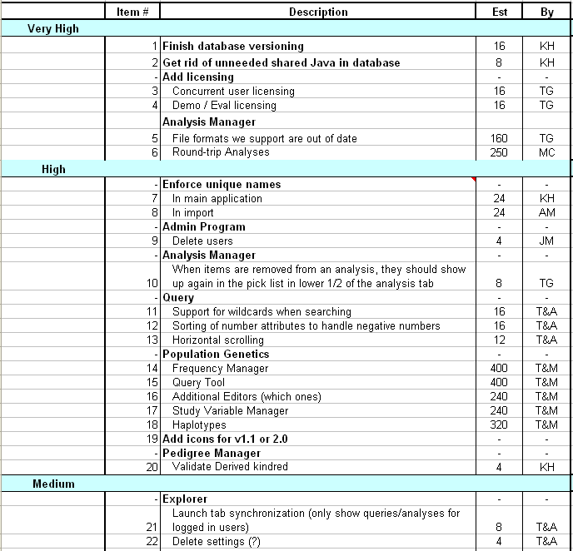
Product Backlog
A list of all desired work on the project, usually a combination of
  story-based work (“let user search and replace”)
  task-based work (“improve exception handling”)
List is prioritized by the Product Owner
  Typically a Product Manager, Marketing, Internal Customer, etc.
Notes:
A sequenced - prioritized list of work:
Use cases
Stories
Requirements
Tasks
Categorized. With estimates as to size (hours, days, LOE) and who made the estimates.
Usually there is a team based planning session, different from Sprint planning, where the Scrum Master and team members perform HL estimates of tasks for the backlog. They usually try to stay “in front of” the team by 2-3 Sprints or so – in their estimating. This time is really not factored into the Sprint – so it is out-of-band time and the impact to the sprint and team is controlled.
It’s only purpose is to represent the requirement or work set for a project and feed that word serially (in priority) towards the team. It often changes as progress / discovery is made.

Slide 15
Sprint Planning Meeting
Product Owner
Scrum Team
Customers
Management
Product Backlog
Sprint Planning
Meeting
Team Capabilities
Sprint Goal
Business Conditions
Technology
Sprint Backlog
Current Product
Notes:
The Sprint Planning Meeting is the central setup facility for the Scrum team. It produces two things:
An overarching goal (Sprint Goal) for this Sprint. This aligns the teams decision-making and work efforts. Functionality can be dropped or partially delivered (or added for that matter) as long as the “spirit” of the goal is maintained and met.
Sprint Backlog of tasks – prioritized for the Sprint, estimated, “assigned” by the team for action
There is a clear “signing up” aspect within the team towards the Goal.

Slide 16
The Sprint Goal
A short “theme” for the sprint:
Life Sciences
“Support features necessary for population genetics studies.”
Financial Services
“Support more technical indicators than company ABC with real-time, streaming data.”
Database Application
“Make the application run on SQL Server in addition to Oracle.”
Notes:
The goal drive the team as much or more than the individual Sprint Backlog items – in that a team can successfully meet the goal and NOT complete all planned tasks. (skipping some and adding some, in order to more effectively meet the “spirit” of the goal).

Slide 17
From Sprint Goal to Sprint Backlog
A Scrum team takes the Sprint Goal and decides what tasks are necessary
  Development, testing, documentation, infrastructure, external tasks
Team self-organizes around how they’ll meet the Sprint Goal
  Managers don’t assign tasks to individuals
  Managers don’t make decisions for the team
ScrumMaster will facilitate team alignment towards the Goal
Sprint Backlog is created & used to drive work during sprint
Notes:
This is really where the rubber meets the road. The team as a whole takes the Product Backlog and maps it to a Sprint Goal and a Sprint Backlog. Picking off the highest priority items and directing them towards the goal.
They then need to figure out how to start.
Work breakdown, who should focus on what
Skill mappings
Determining what can be done in order to meet the goal
Trade-offs
Dealing with skill set and other resource issues (For example: too few developers and too many testers for a given Sprint)
Commit to the goal
The Scrum Master (only) facilitates here. It’s up to the team to figure out how

Slide 18
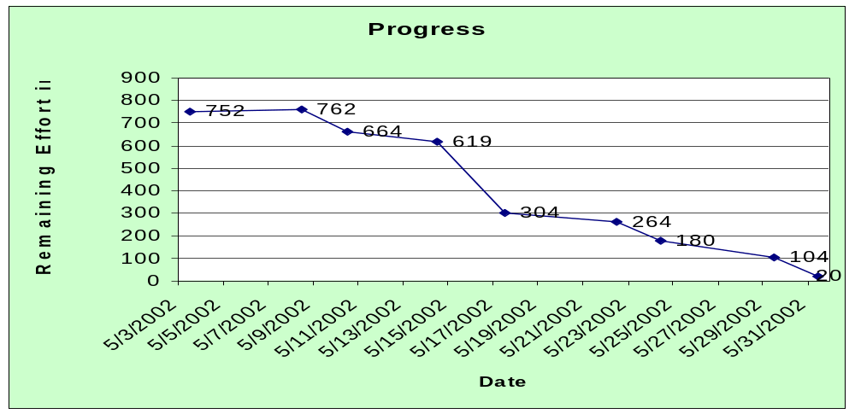
Sprint Burndown Chart
Burndown charts reflect total work planned moving towards Sprint completion. Scrum emphasizes the notion of seeing work reduce over the life of the sprint as a fundamental metric for progress. The charts can reflect a wide variety of work products.
Notes:
From a pure software development POV, you burn down development tasks. However, virtually anything can be tracked in this manner.
One effective listing element are XP stories – in that they can cover all sorts of work items.

Slide 19
Daily Scrum Meetings
Dynamics
  Daily, 15-minute, Stand-up meeting, Facilitated by ScrumMaster. Not for problem solving
Three questions:
  What did you do yesterday?
  What will you do today?
  What obstacles are in your way?
Attendees are “pigs” and “chickens” –
  Pigs (team) speak to above questions
  Chickens (interested observers) attendance helps to avoid other unnecessary meetings
Progress is reported / tracked against the Sprint Backlog
Notes:
You don’t report status to the managers, chickens or the Scrum Master. You report your progress to your team-mates.
It is typical to see the team help one another to face issues and problems, both in the meeting, and daily. Some folks will be “ahead” of their personal work assignments and other will be behind. They should / will be cohesive in working together to meet the overarching goal.
The Scrum Master will typically report out on their “impediment” management steps and actions.
Usually key artifacts are placed in a visible location for team information sharing, including –
Project Backlog
Team information
Sprint Goal
Sprint Backlog
Sprint burndown chart (updated daily)
Daily Scrum issues / status / progress

Slide 20
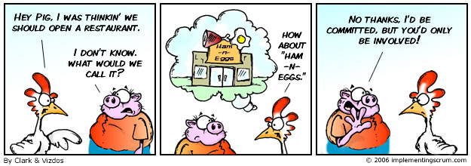
Pigs & Chickens

Slide 21
Sprint Review Meeting
Team presents what it accomplished during the sprint
Typically takes the form of a demo of new features or underlying architecture
Informal
  2-hour prep time rule
Participants
  Customers, Management
  Product Owner, ScrumMaster, Scrum team
Can also morph into a retrospective for lessons learned and in making adjustments for the next sprint
Notes:
I’ve added the retrospective bit. I think the core Sprint Review, is solely focused on the results of the Sprint. However, it seems to be a shame not to take the time to perform a bit of a retrospective as well.
Keep in mind though that the two events may have very different audiences – so there will probably be two separate meetings.

Slide 22
Leveraging Scrum for your Testing

Slide 23
Driving Forces
Simply put – Scrum is a PM “wrapper” – so why not leverage it within your testing efforts?
Support iterative testing
  Backlog, sprint goal driven, team orchestrated
  Measured (burndown) progress to goal
  Daily meetings
Derive clarity with stakeholders for testing focus, sequence and outcomes
Simple PM model – team led, not command led
Notes:
In my experience, software testing is very much of a Sprint based activity. You react to development releases, of varying content and quality, trying to sort through what is working.
Even in a TDD world, it makes sense to perform some sorts of testing in a Sprint based model, for example –
Acceptance testing
User testing
“ility” testing
Performance / load testing
All falling into this category. I’ve found Scrum techniques to be universally useful in coordinating testing activity.

Slide 24
Application Notes
Independent of a full Scrum implementation, targeting testing teams / efforts
Larger teams (2-10+ testers) and independent testing
Can be applied across the testing of a “series” of products and/or releases
Can also be applied towards
  Planning steps
  Lab setup, testing preparation
  Team breaks and employee development / training
Notes:
One note is that the technique doesn’t necessarily have to be – individual product / project focused. If you testing team is focused on integration testing (or systems testing) across a variety of components or applications, it can make a lot of sense to focus this testing into Scrum Test Sprints as well.
I probably want to touch on whether we use this ALL of the time. The answer is no. What I typically do is pull out Scrum practices and use them at appropriate points within specific projects and testing efforts. It’s important to not view this as all-or-nothing – either at the project portfolio level or at the testing effort level.

Slide 25
SCRUM-in-Testing: Overview
24 hours
Daily Test
Meeting
Backlog tasks
expanded
by team
~7-14 days
Goal Driven
Testing Artifacts
Test Sprint Backlog
Potentially Shippable
Product Increment
Test Strategy / Cases / Tasks
As prioritized by Product Owner, Development, and Test team
Notes:
Key phasing to point out:
Backlog is effectively determined by the (Product Owner/Marketing/Customer + Development Team + PM), facilitated with Scrum Master (HL scoping, estimating and partitioning of thinking into possible sprints.
Team takes a Sprint goal and Backlog and unpacks the tasks to determine what can fit into a given Sprint to meet the overall goal. There is a short (4 hours or so) meeting with the team to set the stage and plan for the Sprint. Depending on project / team size, this can expand into a full day exercise.
Iterating on a daily basis
Scrum does “subscribe” strongly to the notion that you leave the Sprint with a work / deliverable piece of the product. Typically the exit entails a review and demonstration of the functionality. From a testing POV, we usually exit with demonstrable assets (test cases run, plans, bugs found, coverage statements, assessment results, etc.)
During each Sprint, the Scrum Master is monitoring content delivery (burndown) within the Sprint and determine carryover and Backlog for the next Sprint or two – looking ahead a bit.

Slide 26
Test Sprint Backlog
Identify a “backlog” of testing activities for the entire project
Prioritize them within the team. In this case:
  Customer and Product Owner
  Development team
  Testing team
This becomes your testing flow and strategy for attacking the product
  Use risk based techniques to identify tasks, phasing and focus
Notes:
It’s important to touch on the backlog as being the effort for the (overall) testing exercise. As such, it changes significantly in time. For example, as the product matures, there will be a series of “bug fix” releases for additional testing. Depending on the number and frequency, adjustments will need to be made.
Content changes (added / changed / removed scope) will also have to be compensated for.
Another factor for the backlog is that LOE or estimated time does come into play when organizing the work. This will occur at an individual task level, by experienced individuals on the team. This will NOT directly translate into the capabilities of the team or the actual individual who may take on the work. The point is there will be a natural “gap” between the Backlog and actual capabilities of the team.

Slide 27
Test Sprint Backlog
Testing task | Priority | Sprint Timing
C1 – Functional – Basic search | 1 | 1
C1 – Functional – Content access | 2 | 2
C1 – Regression | 3 | 2
C1 – Verification | 1 | 1
C1 – Smoke & acceptance | 1 | 1
C1 – Load / baseline | 3 | 2
C2 – Functional – Adv. Search | 1 | 3/4
C2 – Functional – Shopping cart | 1 | 3
C2: Functional – Ordering & billback | 2 | 3
C3 – Regression | 3 | 4
C3 – Exploratory, Searching | 2 | 4
C3 – Load / Production | 1 | 3
Example backlog from a RUP – Enterprise document search application
Backlog ordered collaboratively –
  Delivery
  Coverage
  Time
  Risk
Notes:
Instead of prioritizing individual tasks, I usually identify testing “focus points” for each sprint. They can be as finely granular as daily tasks per tester, or overlap multiple testers and multiple days. Typically, for a two week testing window, I like to identify 5-10 major testing focus points, then prioritize them for the release.
Typically, priority will drive coverage. For example, if I identify repair verification as a priority #1 tasks, then enough members of the team should focus within this area to complete all of the verifications.
In a contrary example, if I prioritize regression as a low priority, than I fully expect the team to take some liberty in this area. At Dialog we have the notion of a “Prioritized Regression”. Think of it as a risk-based assessment of the Regression test cases we should run for an appropriate test cycle or Sprint. We adjust the aspects of the regression as a cross-functional team – factoring in time, goal and priority.

Slide 28
Test Sprints
Testing cycles as sprints
The duration can vary by team and product, but create a tempo for your testing intervals
  Keep the tempo consistent!
  1-2 weeks, most of my experience is with 2 week intervals
  Tied to ratio’s of developer (output) to tester (productivity and scope)
Can also include lab setup, test design, automation, planning and post-release testing activities
Notes:
In my experience, most software organizations release software in “bursts”. In RUP there are construction iterations with testing periods between, in XP there are 2 week iterations, again with the possibility of testing. Testing teams, as a matter of habit, typically react to development deliverables in “sprint” or “bursty” patterns anyway.
Scrum-like Testing Sprints simply provide a framework for wrapping the sprints with a –
Planning Beginning
Daily progress check & Burndown charts for progress
End of Sprint review
There is a relationship or balance between the development team size and the testing team size. I guess in this model – I assume a more balanced model where the testing team can “keep up with” the the development output. This is at a gross level. This model does assume some sort of a balance between development and testing and some sort of Backlog of work. For example, it wouldn’t make sense to apply a 5 person testing Scrum team towards a 1-2 developers worth of output. Unless perhaps there were (n) small developer teams feeding the scrum team.

Slide 29
Test Sprint Goals
Goals should be meaningful and focusing
They should evolve along the product maturity evolutionary path
They should guide the team towards decisions, not presupposing the steps
Should consider previous and upcoming goals – overall workflow
RUP
  E1, E1 – Elaboration / preparation sprints
  C1, C2, C3 – Functional testing sprints
XP – Iteration acceptance testing
Types of coverage:
  Requirements tracing, % coverage
  Performance and load
  Usability, focus groups
  Alpha, Beta readiness
Notes:
One of the greatest habits within Scrum is the notion of Sprint Goals. There’s nothing new here. We always speak in terms of goals in the workplace. However, we rarely fund a way to actualize them within the context of day-to-day activity. The Scrum practice helps us to do that.
If you don’t like the notion of a Goal, then think of it as a Theme, that the testing team is trying to support throughout their testing. To guide their decision-making.
The measurement factor here (or the governor) is the shortness of the Sprint AND the fact that the team is demonstrating an accomplishment at the end.

Slide 30
Test Sprint Goal – Examples
A short “theme” for the sprint:
XP Release
“With the customer, run all acceptance tests for XP iteration #12.”
Database Application
“Develop load testing strategy and design scripts for production release using Oracle upgrade and new clustering .”
RUP Product Release
“Functionally test all C1 delivered Use Cases.”
Notes:
I find that goal oriented Sprints are even more important for testing – in that we can NEVER do everything planned, expected, necessary within a give cycle / Sprint – so having an aligning and clarifying goal is always useful to self-direct the team.
Another useful vehicle are not-Goals, or things that are defined that will absolutely not be touched or tried in a given Sprint. For example, performing Acceptance or Performance testing too early in a series of Sprints.

Slide 31
Burndown Charts & Metrics
Apply the notion of burndown charts to whatever makes sense within the context of the Test Sprint. For example:
  Test case execution rates
    % manual complete, % automation complete, % blocked
  Total # of lab setup tasks, rigs setup, production environment instances setup
  Defect repair verifications
  Test cases designed and reviewed
  Automated tests completed and deployed
  Regression coverage percentages
Notes:
The only real metrics within a Scrum / Test Sprint is how the team is “burning down” the backlog relative to time (14 days) and the Sprint Goal. Everyone should see this progress on a daily basis.
You should also keep in mind the natural ebb and flow points with each Sprint. Here are some examples that effect the burndown rates:
Sprint ramp-up usually take a bit of time to get to your true performance. In a 2 week Sprint, it can take 1-3 days to hit your stride
Usually work and completion of tasks is “bursty”. You’ll have a lull and then show marked progress, then repeat.
Work is usually indicated as Earned Value (or as each item is totally completed)
Finally, you should achieve your efforts with room to spare. Usually a day or so, to prepare for Sprint Review and demonstrations.

Slide 32
Daily Test Scrum Meetings
Every day, entire team, I prefer first thing in the morning
Same 3 questions
Advantages to including specific “chickens” –
  Development (quality, challenges, assistance, prioritization)
  PM & Executives (general progress, challenges, testing focus and prioritization)
  Business (health checks)
Progress, issue management, working towards goal – as a team
Notes:
First the meeting format is each team member reporting to the rest of the team. They’re not reporting status to the Chickens or the ScrumMaster, but to the entire team.
I also look for the team to try and help each other with issues are folks who are falling behind in progress towards the Sprint Goal. There is a transition you look for that is highly visible in the meeting where the team starts to behave more self-directed and
I should also mention the environment for the meeting. I like to capture impediments on a white board in the teams’ meeting room. Then show status at relieving them day-to-day. This is also the place to show progress via burndown charts and other artifacts that express the Sprint Goals, work activity, etc.

Slide 33
Test Sprint Review
No more than a 1 hour meeting
Scrum provides a wonderful mechanism for very fast –
  Sprint accomplishment review
  Work (Sprint Backlog) carryover into next sprint
  Identify adjustments for the next sprint
Then carry this into your next Sprint Goal / Sprint Planning session
Oft times in testing we miss interim reflection or review steps – waiting until the end of the project
Notes:
There are really two aspects to a Testing – Sprint Review.
First, you review overall product quality and findings wrt the expectations when receiving the release for testing. This can be focused on overall maturity and completeness expectations. This feedback should be relayed to the development team for adjustments within the next release and in their internal processes.
Second, was how the overall testing went within the Sprint. This is more of an internal retrospective and intended to drive adjustments for the next Sprint. When your initially starting your Sprints, teams have a natural tendency to over commit to a feasible amount of work (much like their development colleagues). The review is a natural mechanism to make these adjustments at an individual and team level. This should more so take a view to (team) rather than (individual) performance.
There should be an emphasis on some sort of artifact(s) produced. This can take the form of:
Bug reports, overall quality assessment
Coverage figures, exposure, completeness
Planning / setup results
Physical demonstration of the product for the customer
Minimally, I like the result to be an assessment of the (product) related to the (goal) – showing how we achieved the goal. If the goal was setting up a Load testing infrastructure, then we should run a sample Load testing and show results.

Slide 34
Wrap-up
Get over the silly names and animal references ☺
Scrum aligns well to software testing “cycles”
Simple attributes:
  Backlog -> Iterative testing sprints
  Goals -> Self directed teams
  Daily feedback loop, burndown progress
  End of sprint assessment and future adjustments
Value can be derived from using bits & pieces
Self directed – increased buy-in, empowerment and fun!
Notes:
Keep in mind that teams need to (adjust) to self-direction. It doesn’t happen overnight and they can regress into “looking towards” management for their direction. There is also a fine balance to be struck by the Scrum Master. For example, if the team gets “stuck” or “frozen”, it is perfectly ok for them to push, guide or lead the team.
One anecdote on this topic, a useful strategy in “weaning” the team from old fashioned leadership is for the Scrum Master to take time off or leave the team alone during critical planning times or execution times. It forces the team to figure out how to move forward on their own and develop independence abilities.

Slide 35
Break out – Using Scrum Yourselves
Break into small groups:
  Discuss possible integration of Scrum into the groups’ existing work environments and teams
  What do you perceive to be the useful bits to apply
  What might not be useful, and why?
  What would be the key challenges for adoption – in your specific contexts?
  And what could you do to overcome the challenges?
  Let’s de-brief and share...

Slide 36
Thank you for taking the time!
  Any questions?

Slide 37
Acknowledgement
I want to thank Mike Cohn for making available a set of introductory slides for Scrum. I used those slides for most of the content in the “Primer” section. They are made available under –
Mike has a wonderful website where this and other presentations are available on Scrum and XP Planning / Stories – www.mountaingoatsoftware.com
Notes:
I should clearly point this out as part of the presentation and verbally ensure the acknowledgement!

Slide 38
References
DeMarco, Tom and Lister, Timothy, "Peopleware - Productive Projects and Teams", Dorset House Publishing, (1999, 1987)
Hohmann, Luke, "Journey of the Software Professional - A Sociology of Software Development", Prentice Hall, (1997)
Schwaber, Ken and Beedle, Mike, “Agile Software Development with Scrum”, Prentice Hall Publishing, (2002)
Schwaber, Ken, “Agile Project Management with Scrum”, Microsoft Press, (2004)
www.agilealliance.org
www.controlchaos.com
www.scrumalliance.org
http://jeffsutherland.org/scrum/
http://groups.yahoo.com/group/scrumdevelopment/
Notes:
Peopleware and Sociology are just there as some great source on the people / self directed team side of things – for guidance.

Slide 39

Contact Info
Robert Galen
RGalen Consulting Group, L.L.C.
PO Box 865, Cary, NC 27512
919-272-0719
www.rgalen.com
bob@rgalen.com
Software Endgames: Eliminating Defects, Controlling Change, and the Countdown to On-Time Delivery published by Dorset House in Spring 2005. www.rgalen.com for order info, misc. related presentations, and papers.

